Slide 1
Using While Loops
Notes:
Hi, in this video we’re going to learn about how while loops can help us write more sophisticated programs. Let’s get started!

Slide 2
Using if Statements
if hungry:
eat food
if hungry:
eat food
if hungry:
eat food
if hungry:
eat food
if hungry:
eat food
Using if statements, we would need to keep asking the condition over and over.
Notes:
We use if statements to have Tracy make decisions. But what if that decision isn’t a one-time choice? For example, if I’m hungry, I should eat food. But what if I eat a snack and am still hungry? Well, I should eat something else. I only want to stop eating when I’m full but to use if statements to complete this code, we would need to write many lines of repeating if statements.

Slide 3
Using For Loops
Using for loops, we would need to know the exact number of times to repeat the code.
for i in range(??):
if hungry:
eat food
Notes:
We may think to use a for loop in this scenario, but in order to use a for loop, I need to know the exact number of times I need to repeat the commands below. If I don’t know this value, a for loop can’t be used.

Slide 4
Introducing While Loops!
A while loop will keep repeating as long as the condition remains true.
while hungry:
eat food
Notes:
This is where while loops come in handy! We can use a while loop to repeat certain commands as long as the condition remains true. In this case, I will keep eating food while I’m hungry. Once I’m not hungry anymore, the condition is false, and the code will stop running.

Slide 5
Writing While Loops
while condition:
Commands to be performed go
here (indented!)
*Beware of creating an infinite loop!*
Notes:
To write a while loop, we simply use the word ‘while’ and follow it by a condition and a colon. The condition is written the same way we write conditions in if statements and the commands we want to perform while to condition is true are indented below.
(Click for label) There is one thing to be cautious of when writing while loops. If we use a condition that never becomes false, our code will repeat indefinitely and we will have created what is called an ‘infinite loop’. Creating a loop that never ends will cause the program to crash so make sure you include a stopping point where your condition becomes false.

Slide 6
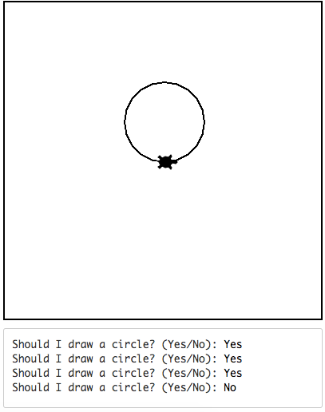
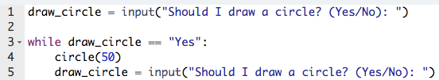
Using User Input in While Loops
False
True
As long as the user continues entering “Yes”, the code will keep running.
Notes:
Let’s look at this example. We are asking the user if they want to draw a circle. The user has answered yes. (Click for green arrow) The while condition is then true, so the commands below are performed (Click for circle and input) and Tracy draws a circle and the user is asked again if they want a circle.
(Click for green arrow) The condition then is checked and still found true (Click for input) so Tracy draws a circle and asks the user again.
(Click for green arrow) The condition is still true (Click for input and label) so Tracy draws another circle and the user is again asked. Notice that as long as the user answers ‘Yes’, the code will keep running.
The condition is checked (Click for red arrow) and is now found to be false so the code ends.
Let’s look at how we can use while loops in our Tracy programs.

Slide 7
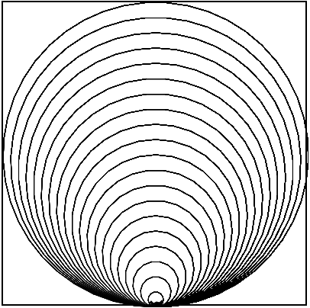
Example #1: Increasing Circles
Write a program that has Tracy draw a circle with a radius of 10 on the middle bottom of the canvas. Increase the radius by 10 and continue drawing circles until the circles will no longer fit on the canvas.
Notes:
In our first example, we want Tracy to draw circles starting at radius 10 where each circle’s radius is 10 pixels larger than the one before. We want Tracy to stop drawing circles once they will no longer fit on the canvas.

Slide 8
Commands Learned this Lesson
Command | What does it do?
while condition: Commands to perform | Initialize a while loop
Notes:
In this lesson, we learned how while loops can be used to repeat code while a condition remains true. Use while loops to solve your next Tracy challenges!

